Slide 1


UiPath RPA Nanyang Polytechnic School of Information Technology

Slide 2

Data Table and Data Scrapping
What Is Data Scrapping?
Data Scrapping from Data.gov.sg

Slide 3

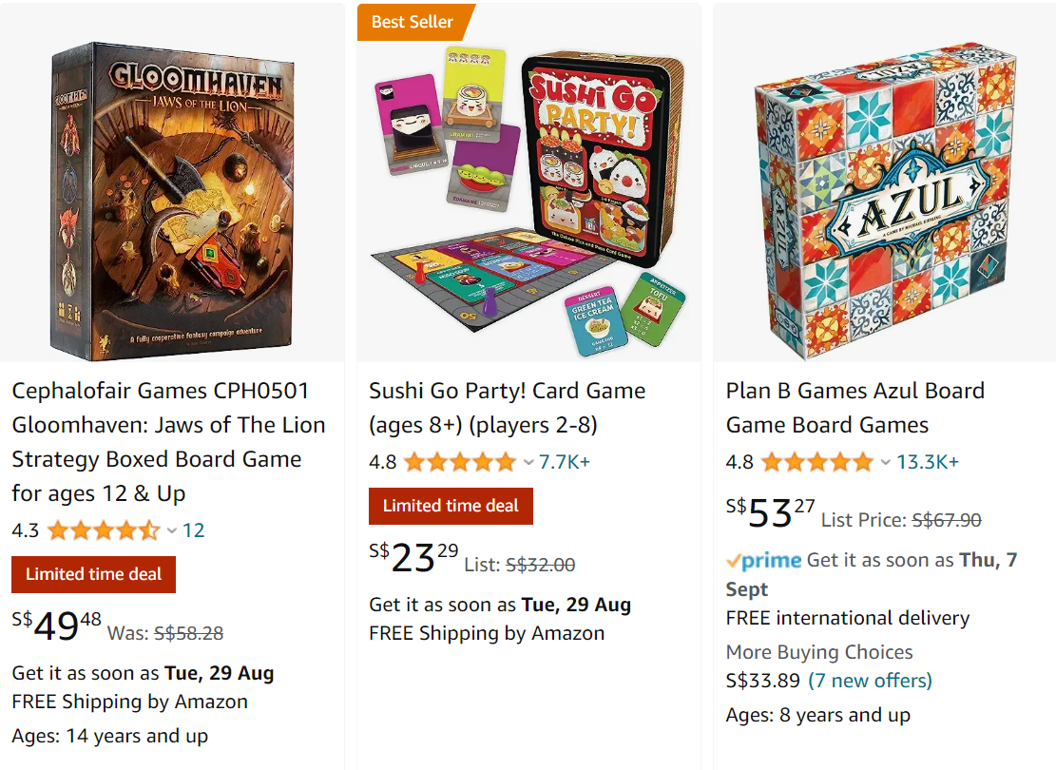
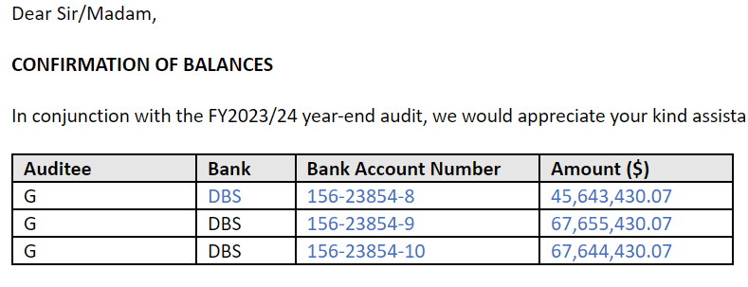
Data Scraping
Data scraping enables you to extract structured data from your browser, application or document.
But… What is structured data?
Structured data is a specific kind of information that is highly organized and is presented in a predictable pattern.
Example: Table from an email.
Example: Product listings
Notes:
IV. Click on the Data Scraping icon on the top left corner of UiPath Studio. Then an activity window will pop up which showing as a next button. You can click on it and START the next activity data scraping.

Slide 4

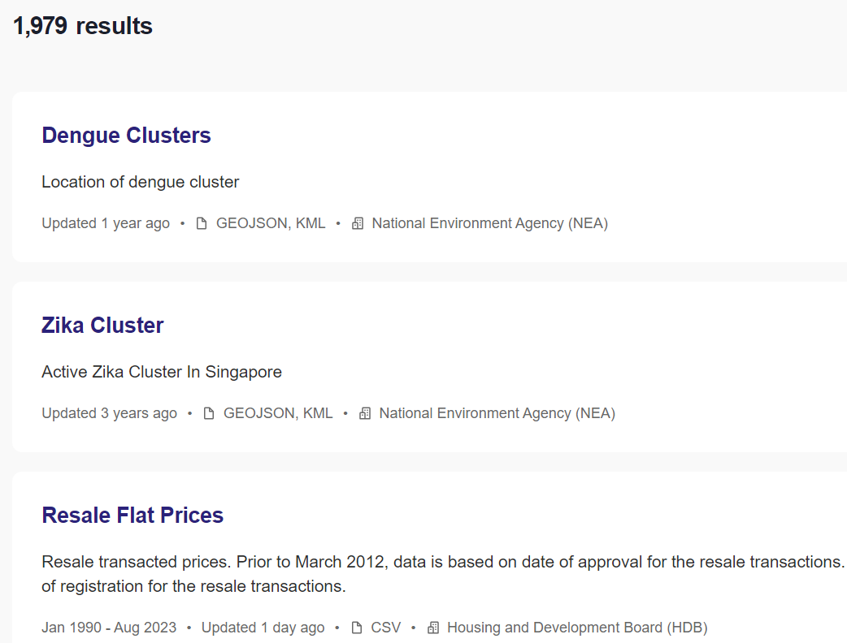
Examples of Table extractions
Example 1:
Data scraping from Data.gov.sg
Example 2:
Data scraping from Email content

Slide 5
Data Table and Data Scrapping
Setting up plugin for Data Scrapping
Data Scrapping from Data.gov.sg

Slide 6
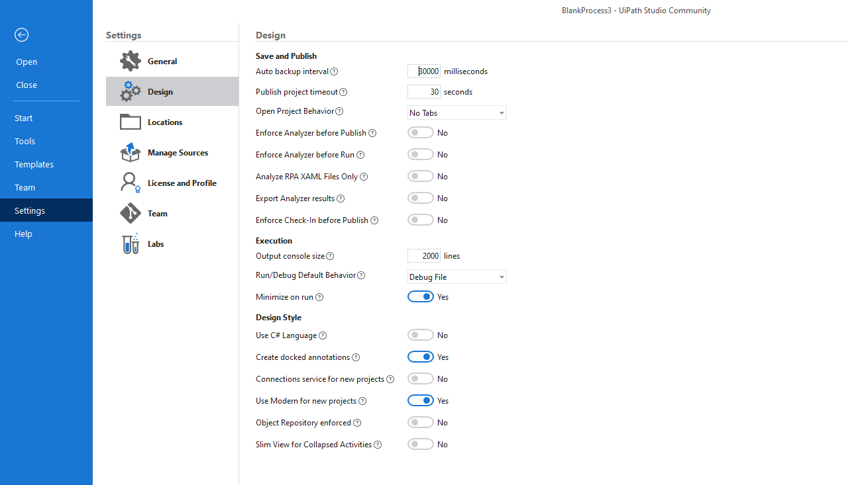
2) Click on Design
1) Click on Setting at the start. If you are in the process flow page, click Home, then Setting
3) Click on Modern

Slide 7
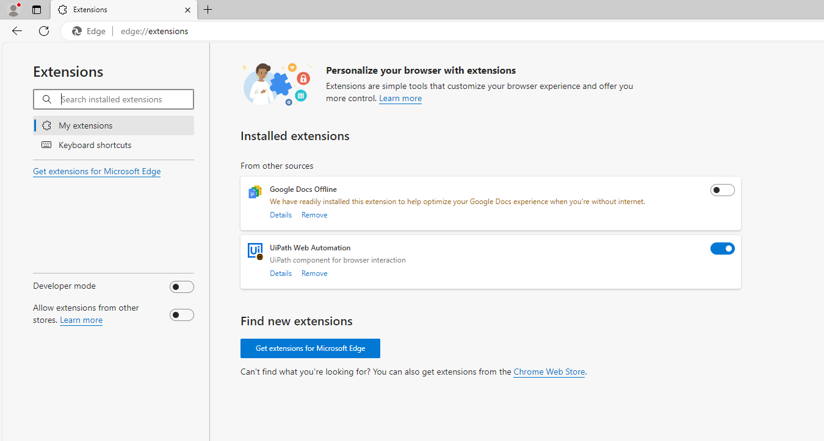
1) Type edge://extensions in browser
2) Enable the uipath web automation

Slide 8
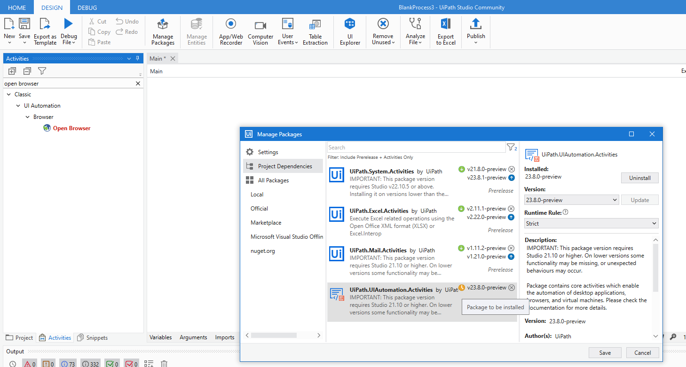
1) Click on Manage packages
3) Click on update
2) Click on the UI automation.Activities packages
5) Click on the blue arrow
4) Click save

Slide 9
Data Table and Data Scrapping
Setting up plugin for Data Scrapping
Data Scrapping from Data.gov.sg

Slide 10
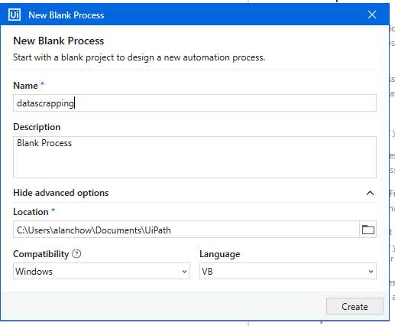
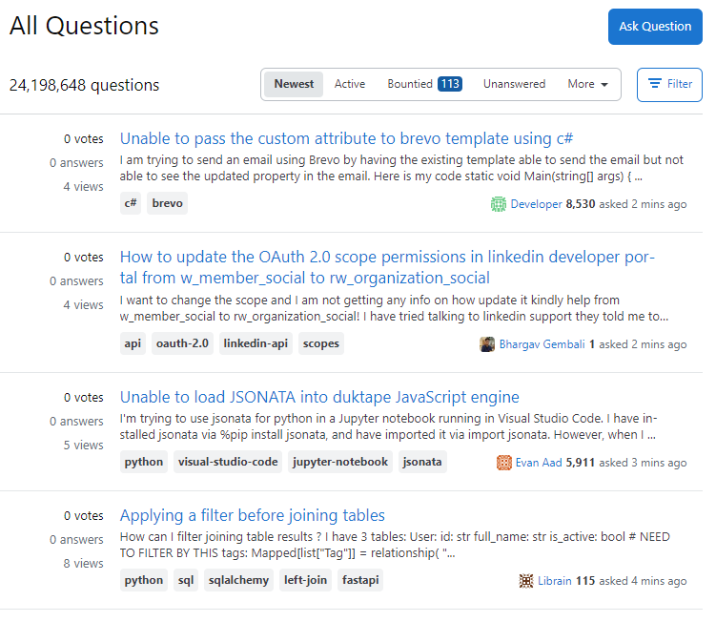
Data Scrapping
Notice that the data are multiple rows but repeated. → Structured Data!
Create a new project:
Home→ New process
Name the Process:
Datascrapping

Slide 11
First, we need to open the Edge Browser and view the site for data scrapping.
Access the site
Topic
As you can see, there are 5 important data to extract from MULTIPLE ROWS.
After extracting from the table, we then need to write to an excel file using write range activity!
Solution
Technology

Slide 12
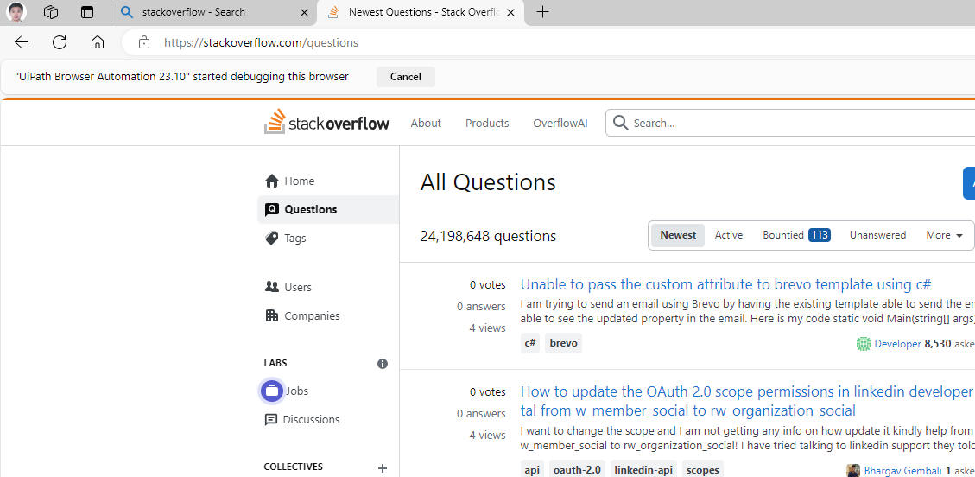
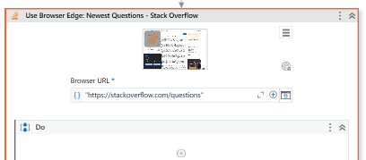
Local Gov.sg file
(only for WOG computers)
Use “https://stackoverflow.com/questions” as the URL for Open Browser.
Open stackoverflow in Browser
Make sure your URL text is enclosed in double quotes.
(E.g. “google.com”)
Notes:
Newest Questions - Stack Overflow

Slide 13
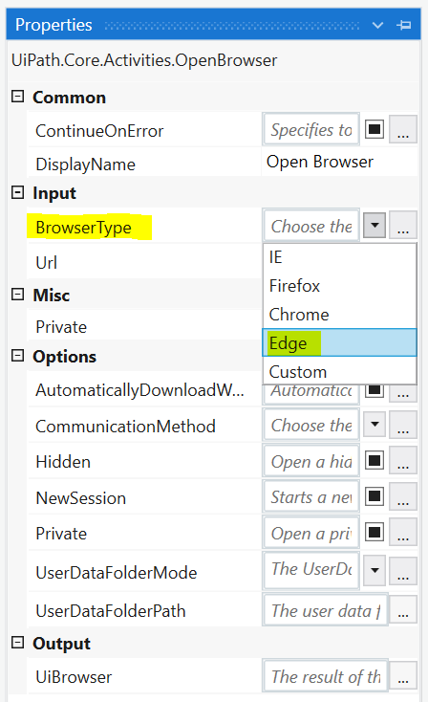
Updating properties of Open Browser
Update your Open Browser activity to ensure it opens in Edge browser.
Properties panel → Browser Type→ Edge
This means that Edge browser will open the URL
IMPORTANT: When doing any automation steps, make sure you are consistent across different browsers.
If you are doing table extraction using chrome Browser, then you must choose Chrome for Open Browser, or automation will not work.

Slide 14
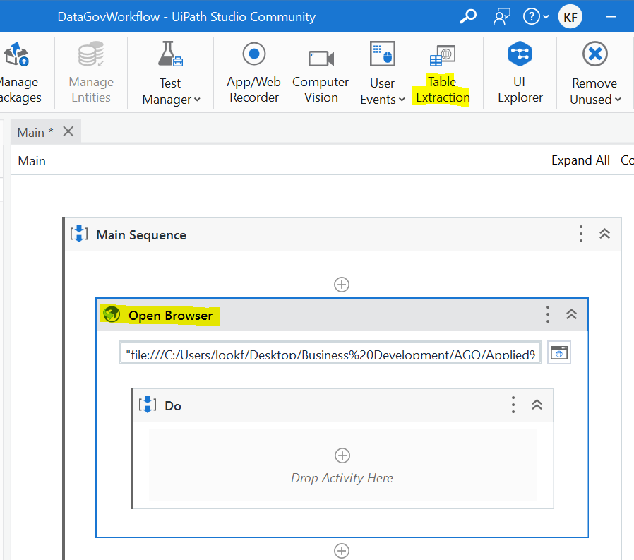
Table Extraction Wizard
This allows you to select the data you need for extraction of data from sites or other software
Table Extraction Tool:
Part of the Modern Experience in Studio
Enables you to automatically extract structured data from applications and save it as a DataTable object
It will AUTOMATICALLY add some activities into the sequence after you finished giving the instructions.
Make sure you click on the Do sequence inside Open Browser activity before clicking the Table extraction Tool.
This means that the Table Extraction Tool will add its activities INSIDE Open Browser.
“https://beta.data.gov.sg/datasets?sort=Most%20downloads”

Slide 15
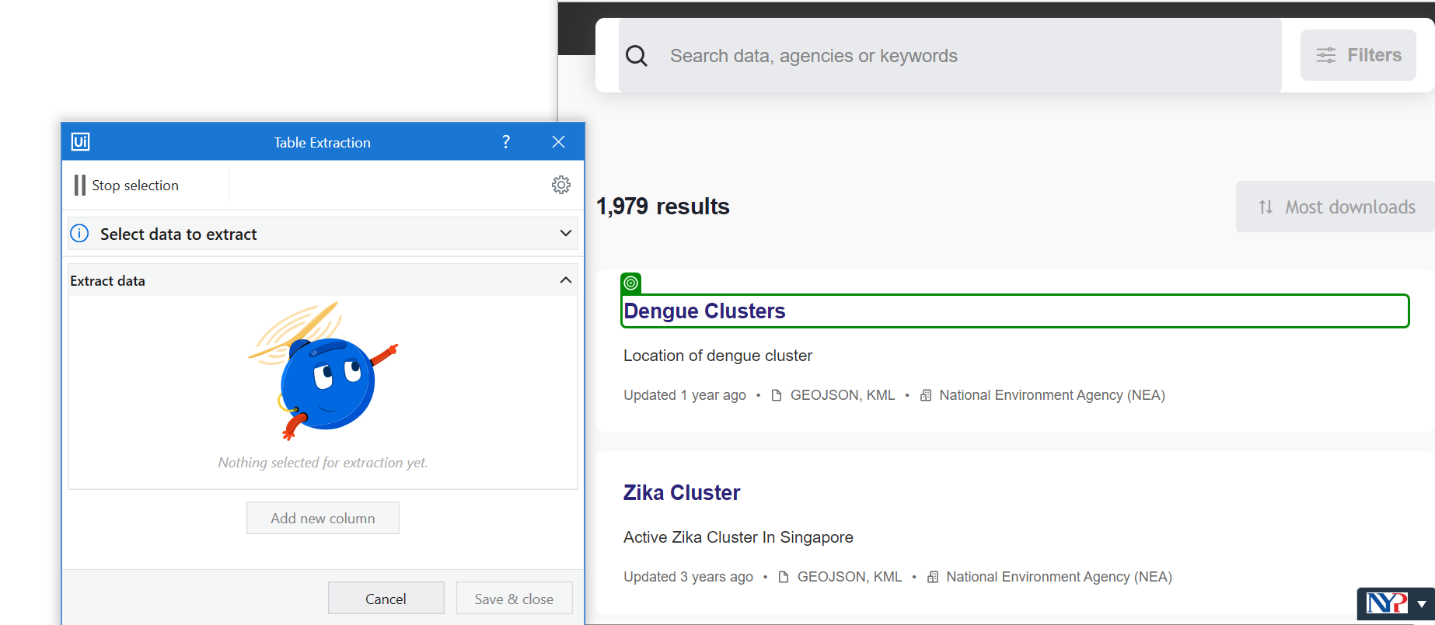
Table Extraction Wizard
The Recorder allows you to select the fields you want.
The recorder will appear.
Open up the window with the Data.gov.sg in Edge Browser.
Now, we want to select each data field one by one (by selecting them in the first row of the page.)

Slide 16
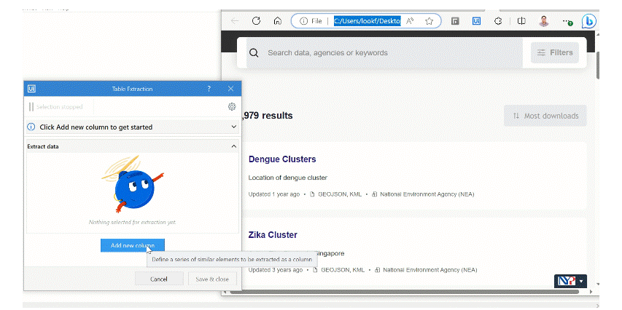
Quick overview of the steps
The Recorder allows you to select the fields you want.

Slide 17
Table Extraction Wizard
The Recorder allows you to select the fields you want.
Click on the dataset Name in the first row.
You will notice as you mouse over any data field, it will be highlighted in Green. This is UiPath recorder trying to find your fields.
Click on Add new column
This allows you to choose your first field, which is the Dataset name

Slide 18
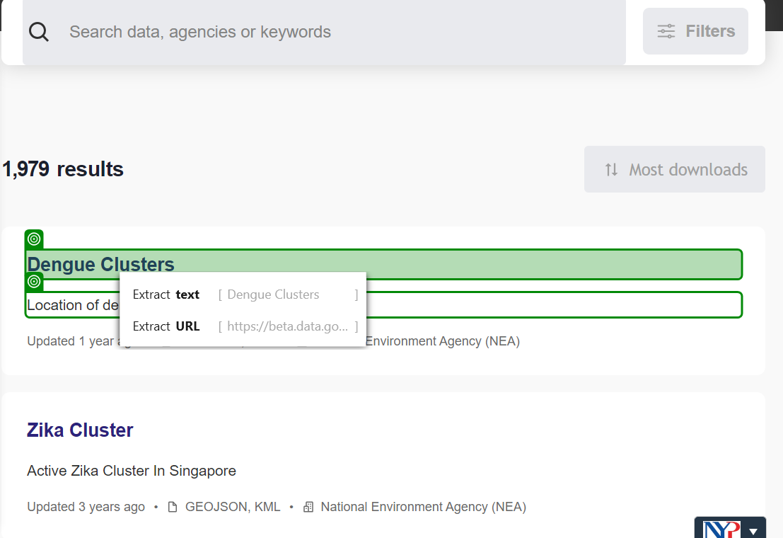
After clicking, 2 options may appears.
Extract text→ the column contains the text
Extract URL → the column contains the URL to the dataset.
Choose text
The Table Extraction tool is powerful. There is AI logic in the background matching ALL ROWS in the page to the Dataset name field that you just selected!

Slide 19
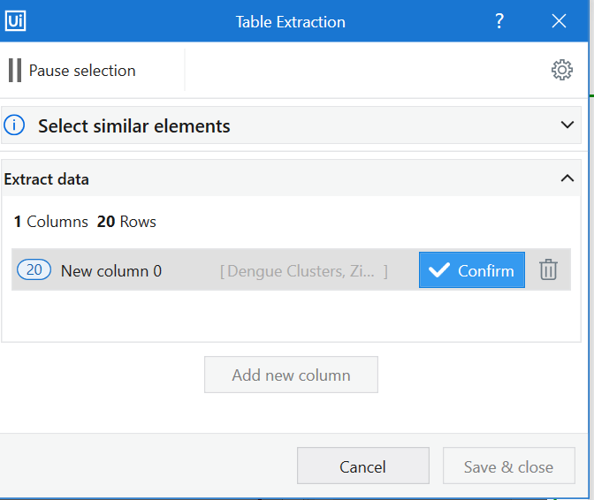
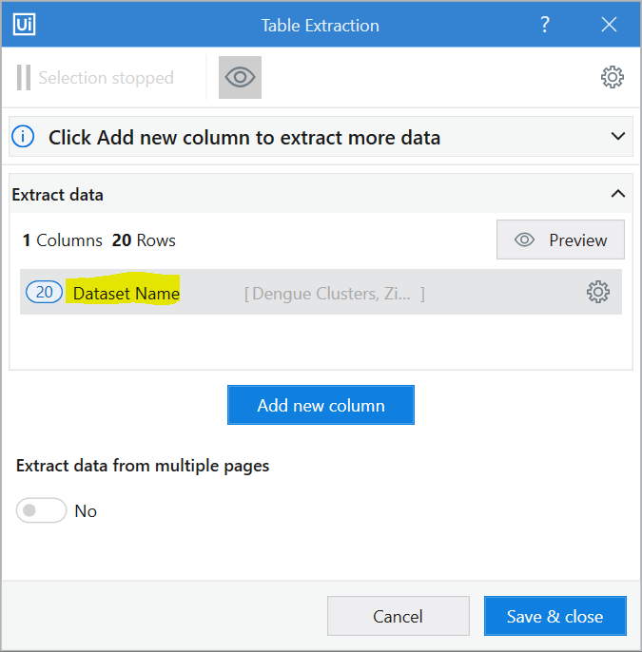
Updating the selected field name
In the recorder, you can update the field name to something more contextualized. E.g. Dataset name instead of New Column 0
Click on Confirm.
Change the column name to Dataset name.

Slide 20
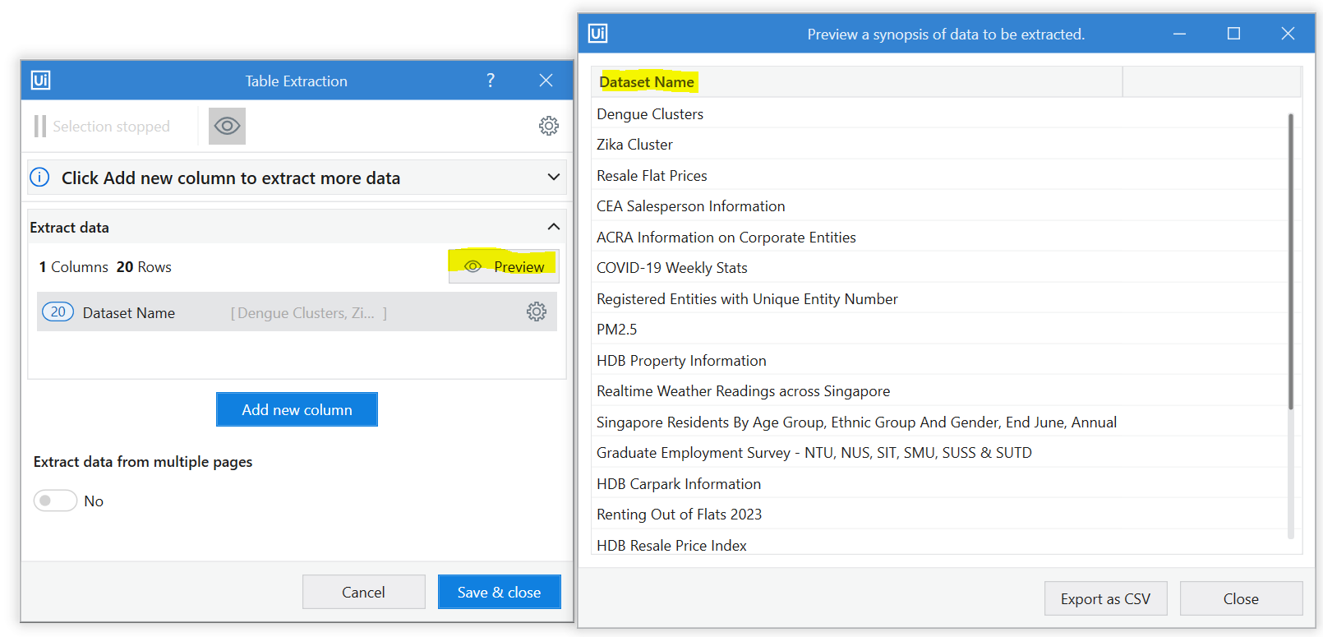
Previewing data extraction
In the recorder, you can review the data just to double check if it is accurate.
You need to then do the exact same steps for all the data fields!

Slide 21
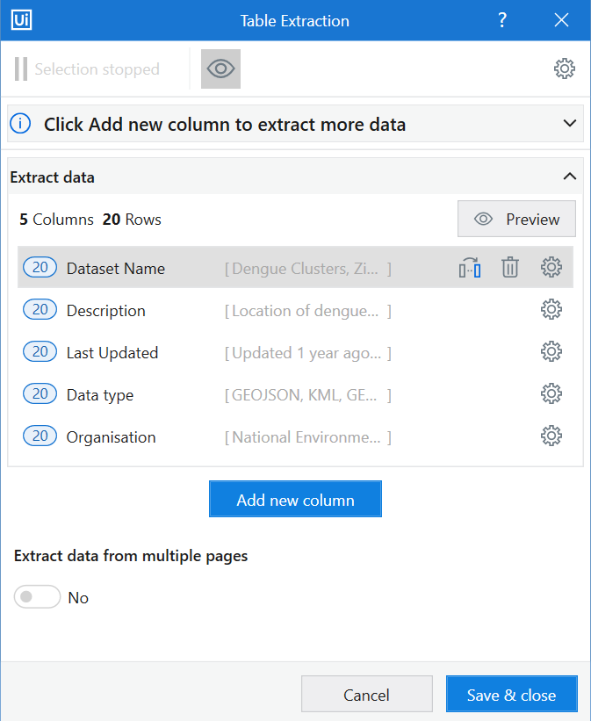
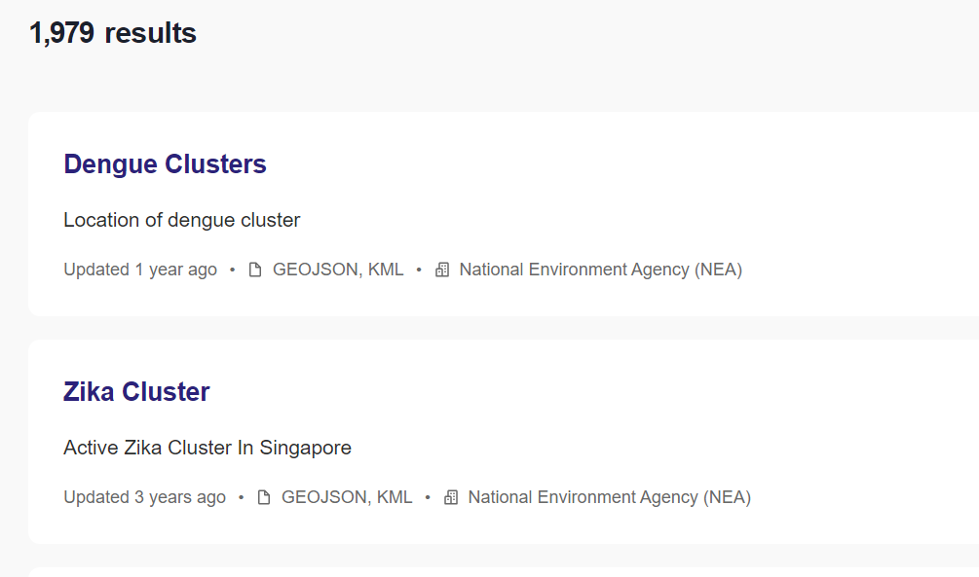
Extract multiple fields
Now repeat for all the fields.
Dataset Name and URL
Description
Last Updated
Try it yourself! Remember for URL, choose Extract URL for Dataset Name.

Slide 22
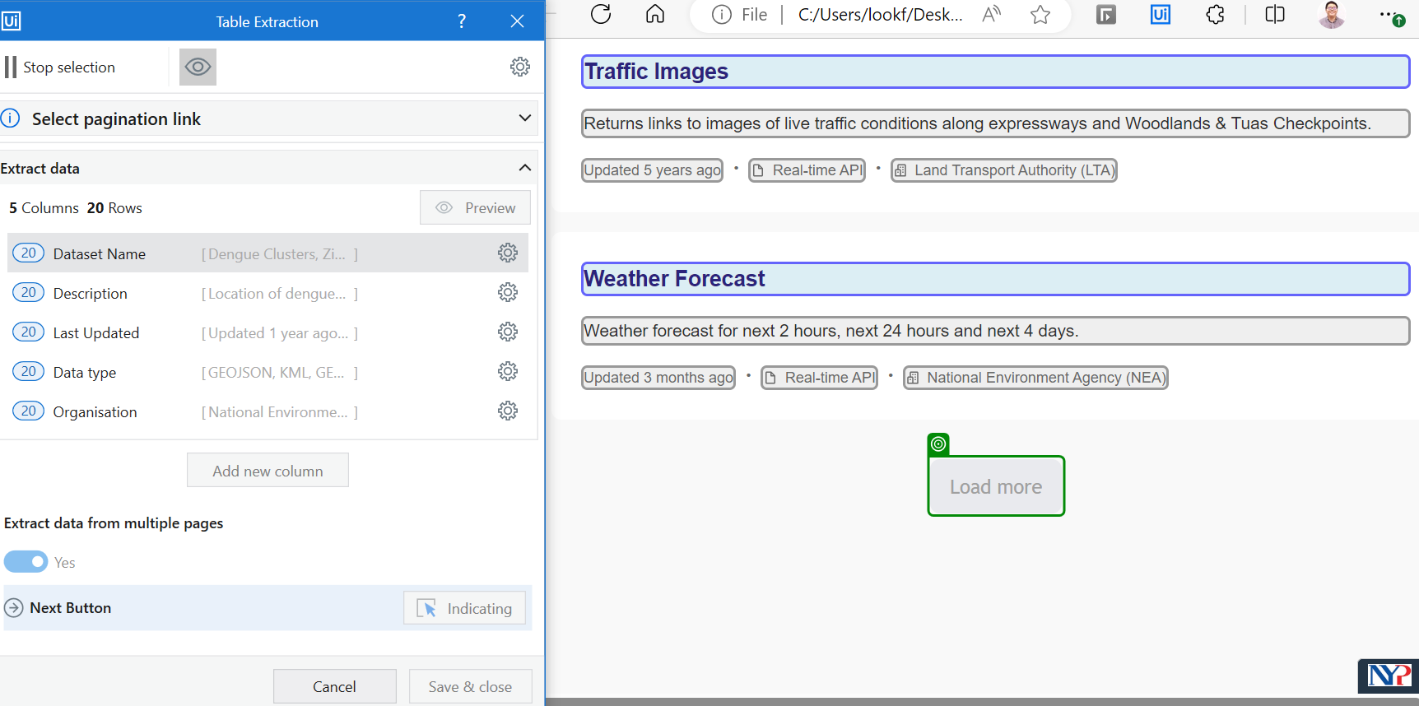
Extract multiple pages
This is important as you can choose to extract data from multiple pages (paging) by indicating the Next button. In this case, select the Load More button.
Toggle this
Scroll down and Select the Load more button. This means if UiPath detects more rows/pages to scrap, it will continue by click on this button.
After that, click Save & close.

Slide 23
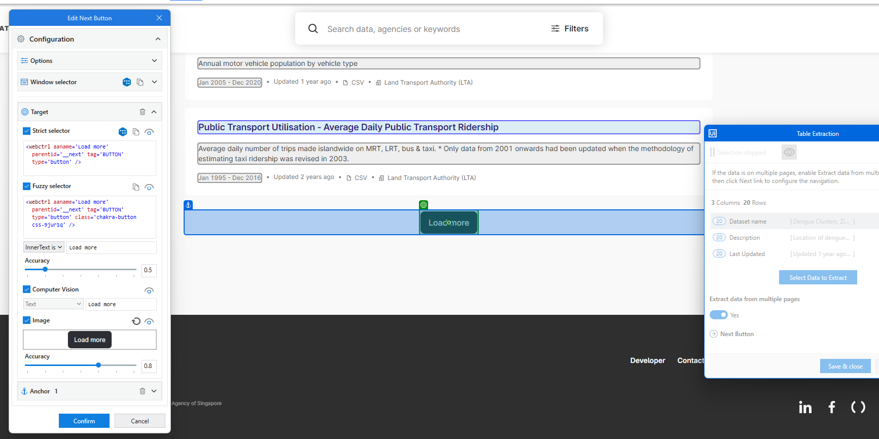
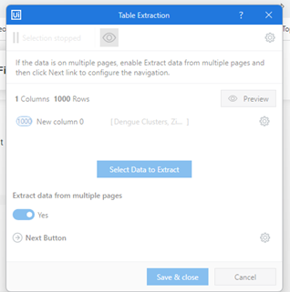
3) Select strict selector for the tag
2) Use an anchor tag to make the capturing more precise. Select the div that wrap around the button
1) Click on the engine button to set anchor tag

Slide 24
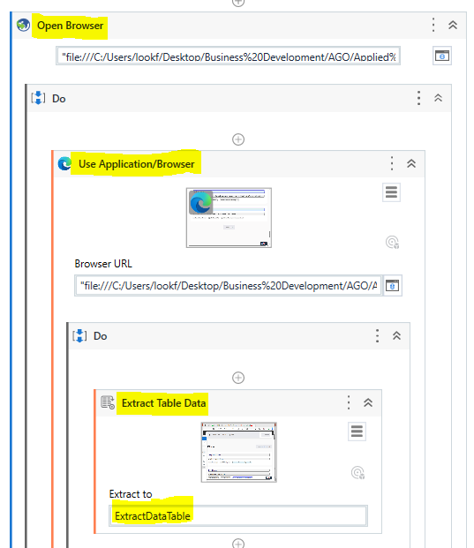
Check your
Generated
activites
After this is done, the following activities will be added to the sequence. Please make sure they are in the DO sequence in the Open Browser to work correctly.
These 2 activities are generated:
Use Application/Browser→ Will allow UiPath to find the window to perform extraction
Extract Table Data → Saves the Data into a DataTable. Note that the variable name is ExtractDataTable (auto-created)
With the data extracted, we can then use it in many ways such as:
Loop and perform tasks
Write range into a new Excel Sheet

Slide 25
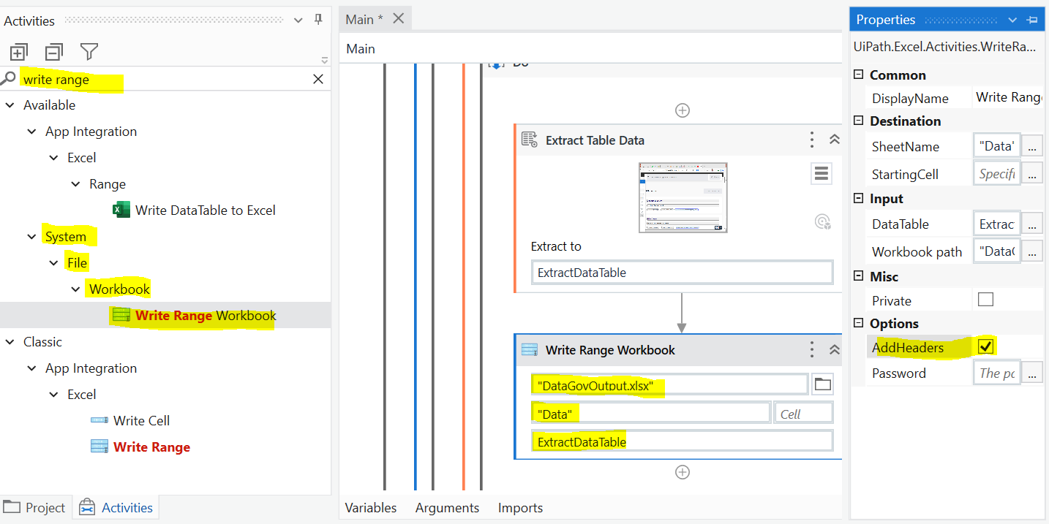
Write Range into
a new Excel file
Write Range will directly create a excel file into the project folder if path is not specified. File extension (.xlsx) must be typed in as well for file name.
1) Search and add the Write Range Workbook activity to BELOW Extract Table Data activity
Make sure you check Add Header for the properties of Write Range Workbook.
Type the following:
Workbook path→ "DataGovOutput.xlsx“
Sheet Name→ “Data"
Data table→ ExtractDataTable

Slide 26
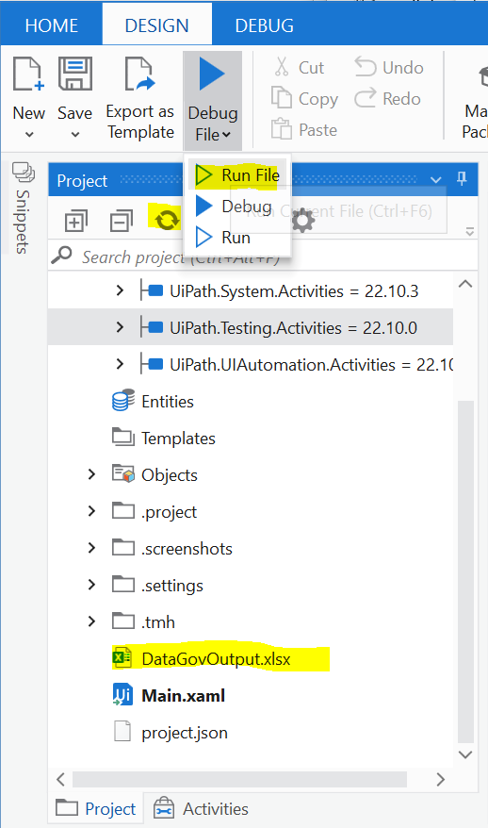
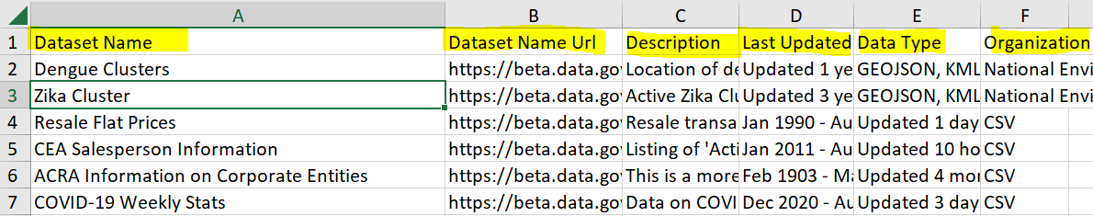
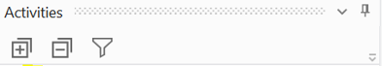
New Excel generated
Write Range will directly create a excel file into the project folder if path is not specified. File extension (.xlsx) must be typed in as well for file name.
Refresh the Project panel to see the Excel file.
Run the robot. After it completes, click on the refresh icon
The DataGovOutput.xlsx file should be generated. Double click to open it in Excel.
If the excel is not found, you may use the filter button and select objects and others

Slide 27
Data Table and Data Scrapping
Setting up email and plugin for Data Scrapping
Extra Exercise: Scrapping from MOE

Slide 28
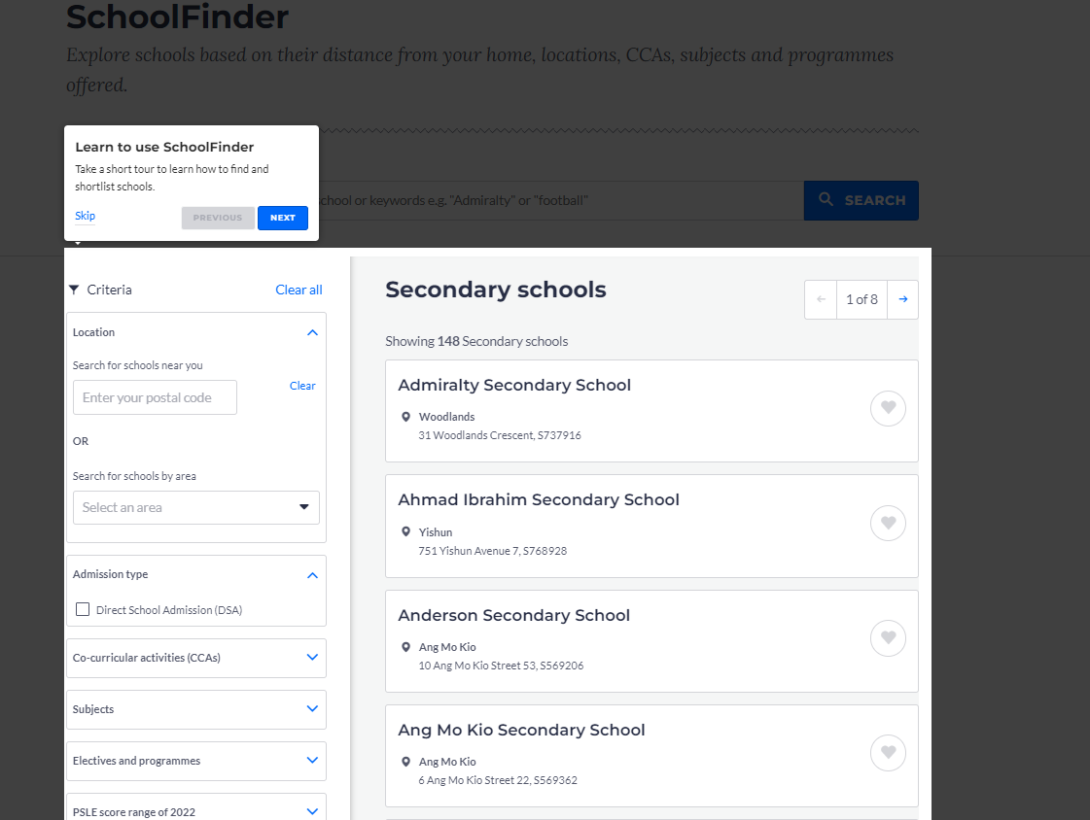
Try it yourself!
Go to this URL: https://www.moe.gov.sg/schoolfinder?journey=Secondary%20school
2) Your goal is to extract all the
School name,
Town area
Address
3) Finally, write the result to an excel file. The result can potentially be used to create a dashboard or heatmap.

Slide 29
Supplementary Slide Chrome Extension for UiPath
Install From UiPath Studio
Open Studio.
Navigate to Home > Tools > UiPath Extensions.
Select Chrome > Install. Choose one of the available methods from the drop-down:
Group Policy Offline
Group Policy Online
All Users
Current User
Native Host Only
Open Chrome and navigate to chrome://extensions.
Enable the UiPath Web Automation extension if needed.
https://docs.uipath.com/studio/standalone/2023.4/user-guide/extension-for-chrome

Slide 30
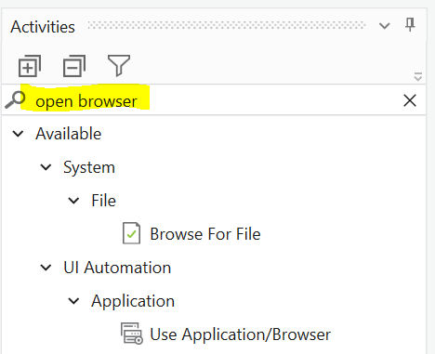
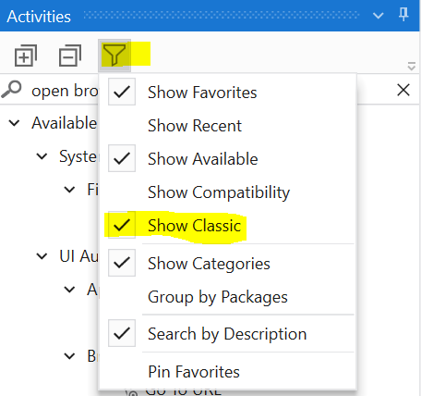
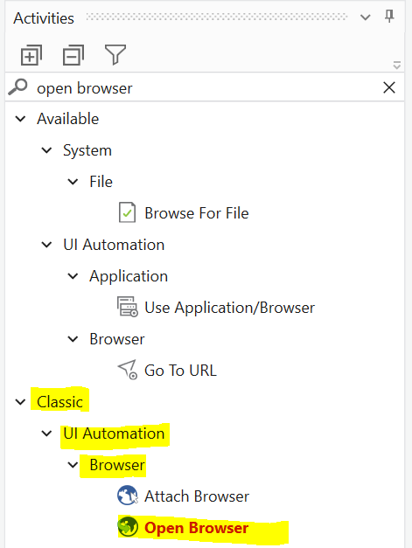
Search for Open Browser in the activity panel.
Can you find it?
Classic View
Some activities are hidden behind the classic view.
Modern Design Experience → more intuitive and user-friendly
Classic Design Experience → is more powerful and provides more flexibility (More codes)
In this case, let’s set the filter to show classic view. Add the open browser activity to the sequence.

